Slide 1
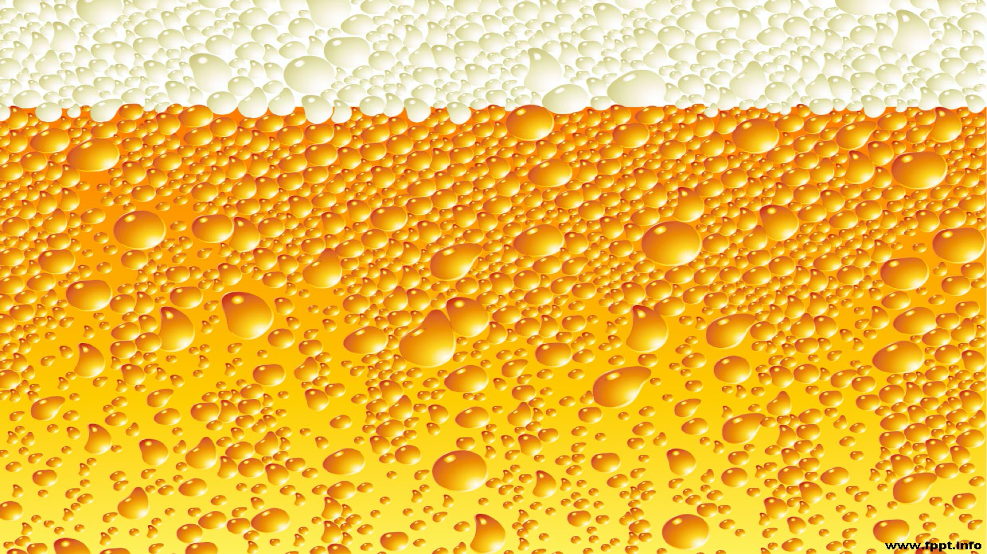
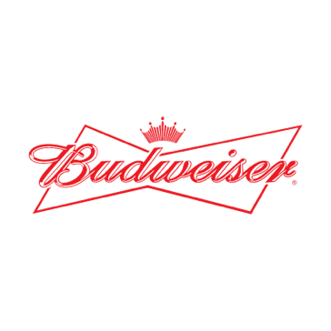

Case Study:
Beers and Breweries
Eric Romero
Samuel Onalaja
Amber Lea Clark
Notes:
Samuel, Amber and Eric introduce ourselves

Slide 2
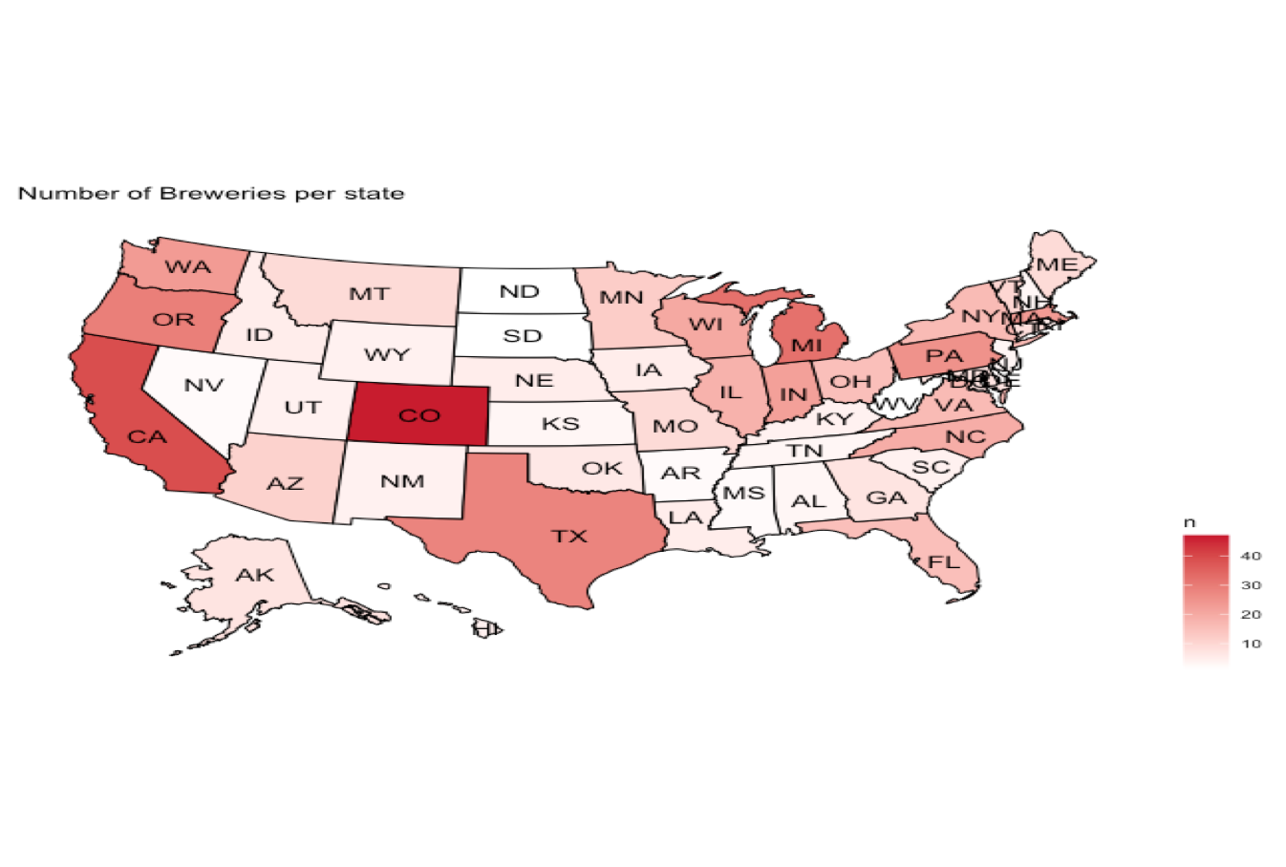
Breweries by State
Notes:
Amber - Colorado is the state with the most breweries. West Virginia has the least breweries. There isn’t an obvious trend in the US as far as number of breweries. One could say that coastal states have a few more breweries per state compared to landlock states except Colorado.

Slide 3
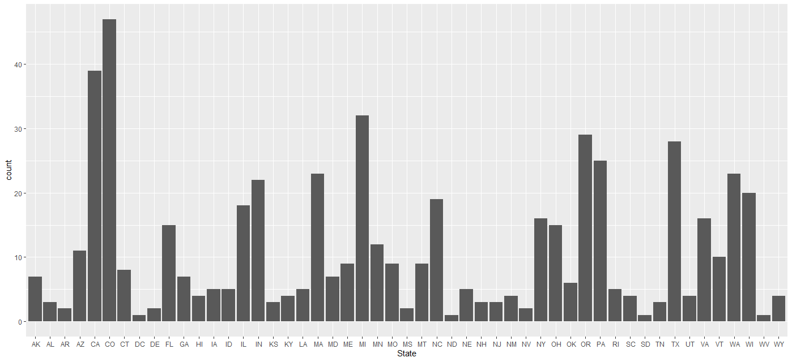
Breweries by State
Notes:
Amber - On this slide you get a different representation of the number of breweries by state in alphabetical order.

Slide 4
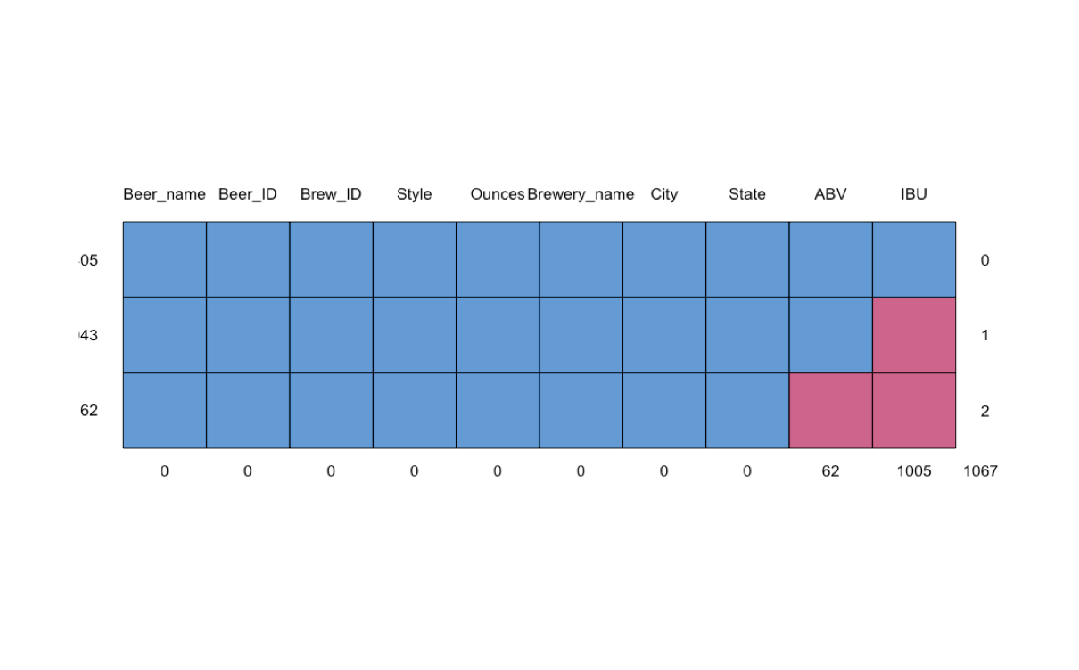
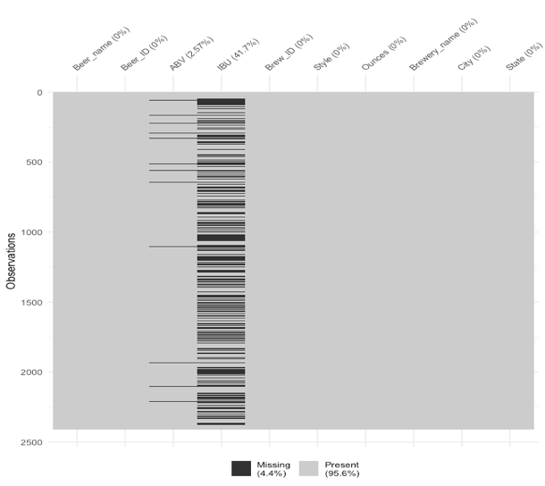
Missing Values
•ABV had 62 missing values (2.5% of observations) and IBU had 1005 missing values (42% of observations).
•These missing values can be address by filling in the median ABV and median Value for each of the missing field for both variables
Notes:
Samuel

Slide 5
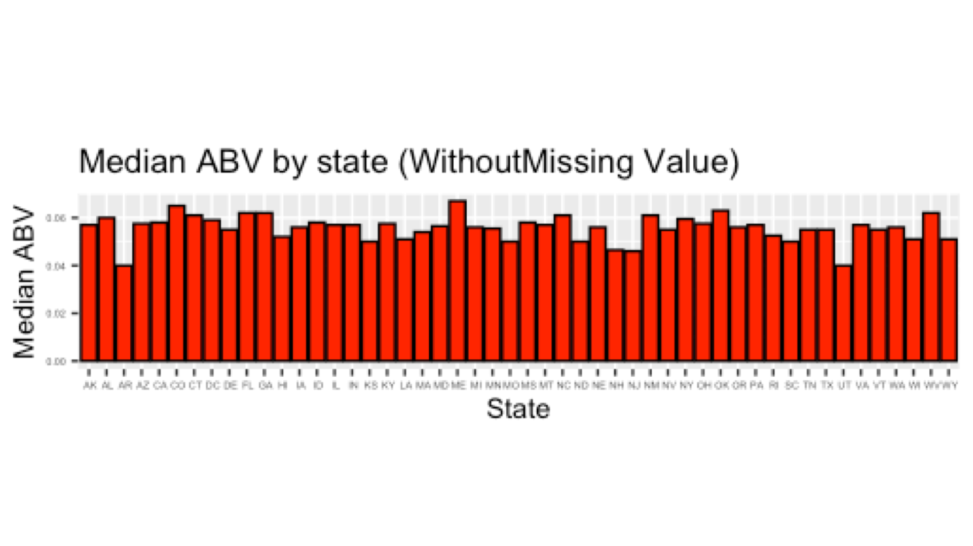
State Median for Alcohol by Volume (ABV)
Notes:
Amber - ABV for all states is above 0.04. The majority of states ABV is 0.06.

Slide 6
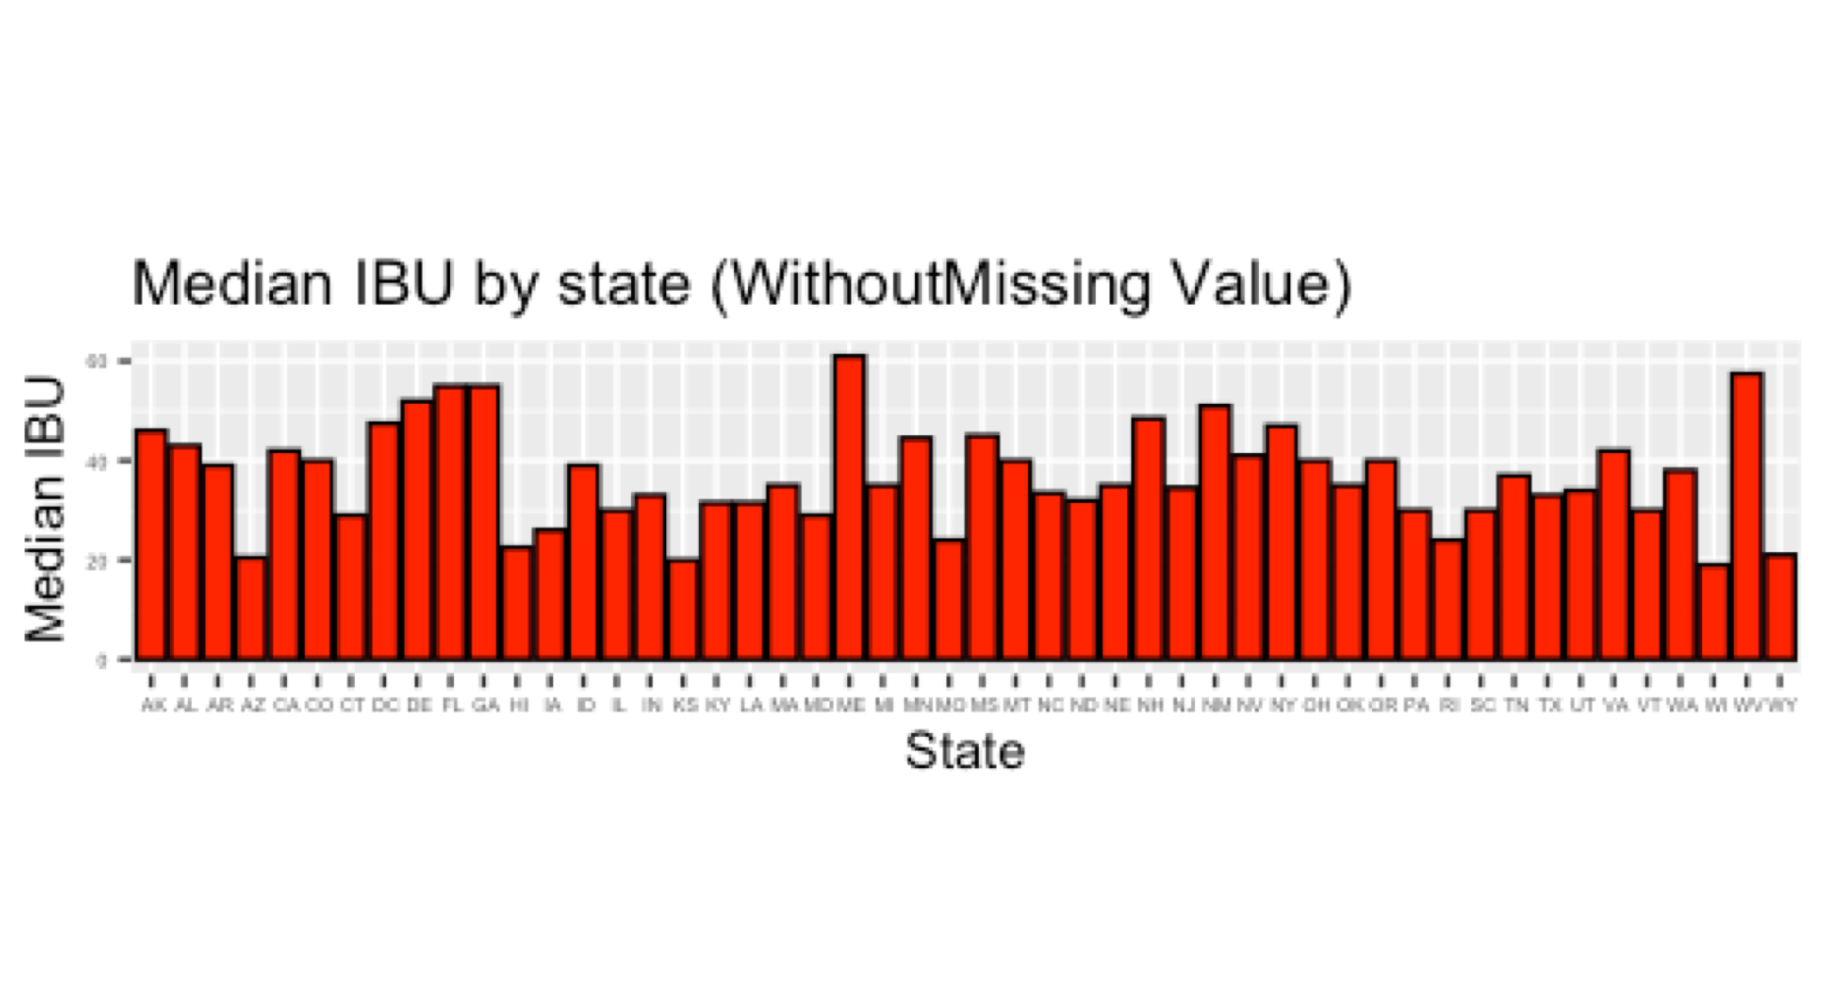
State Median for International Bitterness Units (IBU)
Notes:
Samuel - Maine and West Virginia have the highest IBU of 60 or slightly above. The lowest are Arizona and Wisconsin at approximately 20 and it looks like we have more variation on the IBU compare to ABV

Slide 7
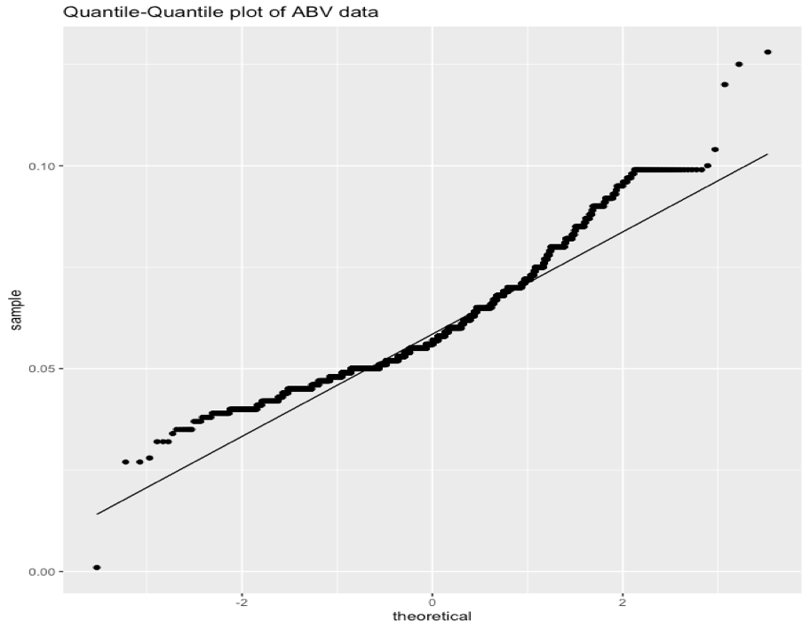
Summary Statistic of ABV
•The mean value at 0.05977 is slightly higher than the median value at 0.05600, which indicates a right skewed distribution which means the alcohol content is not so strong.
•From the upward curve in this plot, we infer that the data are somewhat skewed. The obvious discontinuities at the ends of the curve are an indication that the ABV values have a few outlier.
Notes:
Samuel

Slide 8
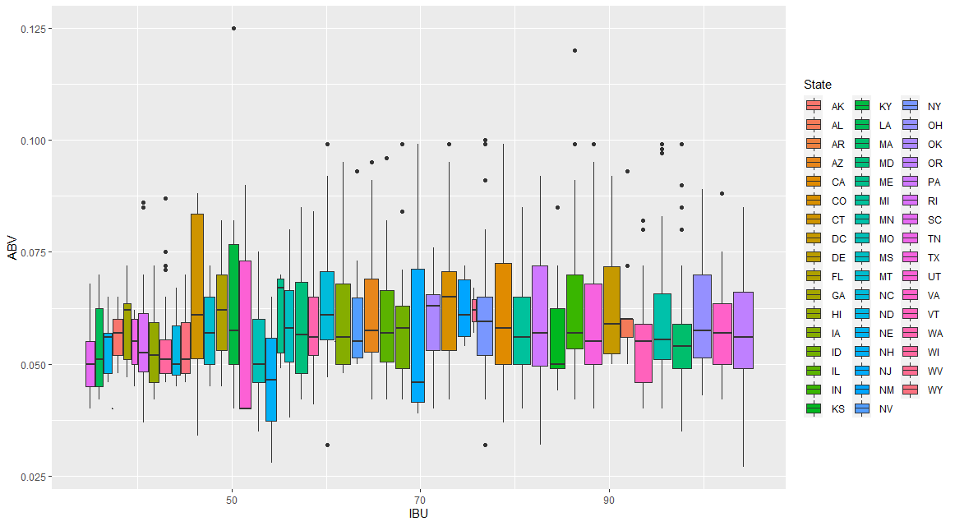
ABV and IBU Variance by State
Notes:
To take an indepth look at the ranges between ABV and IBU we created a boxplot to show the variances of each variable by state. Here you can see the heights and widths of each box representing the range of ABV and IBU respectively for each state.

Slide 9
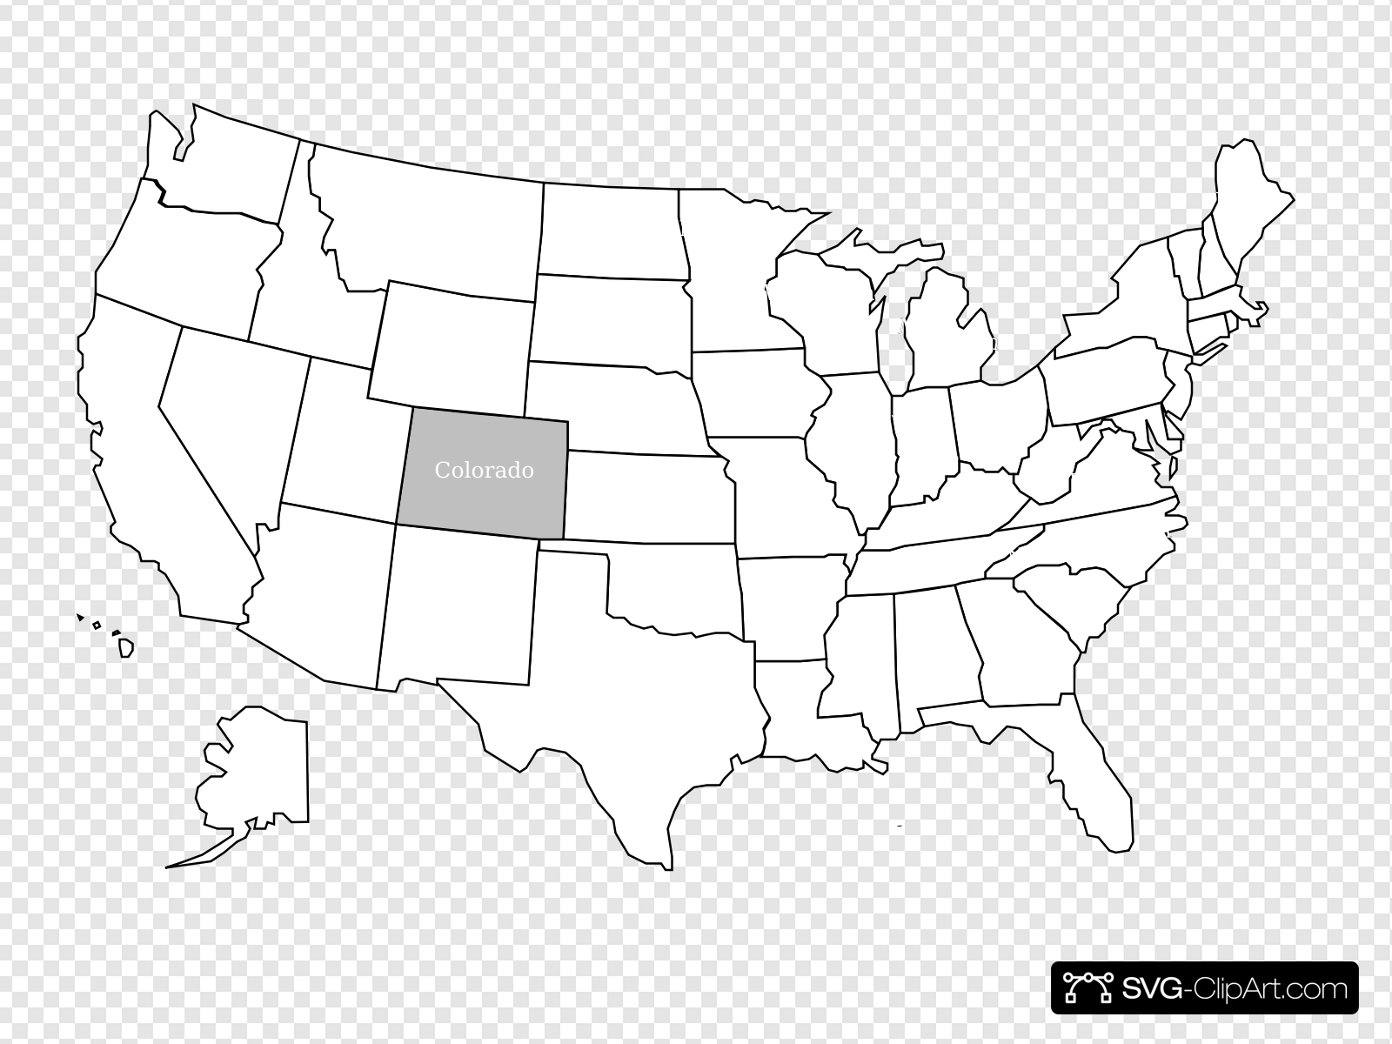
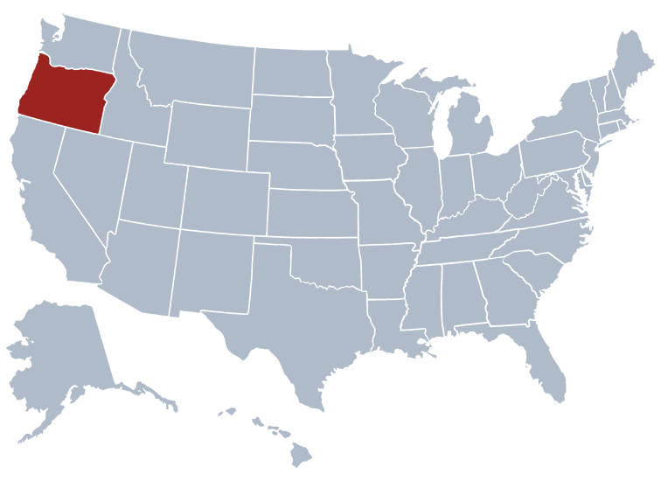
Highest ABV and IBU by State
Colorado has the highest ABV of 0.128: Lee Hill Series Vol. 5 - Belgian Style Quadrupel Ale
Oregon has the highest IBU of 138: Bitter Bitch Imperial IPA
Notes:
We checked the cleaned data set against the original that contained some missing values and found the highest values for ABV was 0.128 in Colorado while the highest IBU value was found to be 128 in Oregon. Considering the data that had no missing values, Kentucky had the second highest ABV value at 0.125.

Slide 10
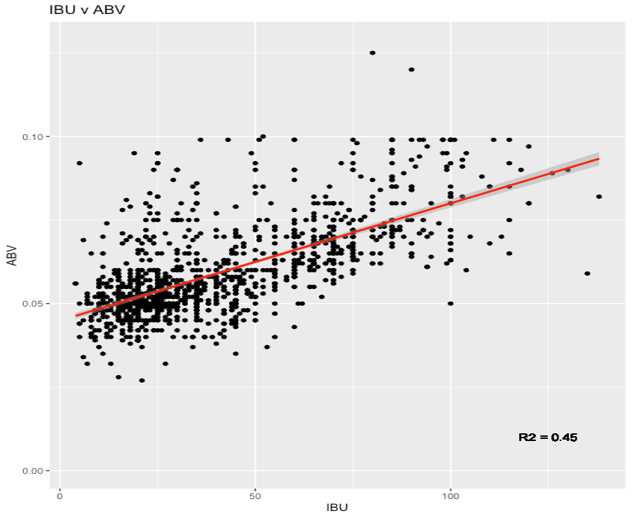
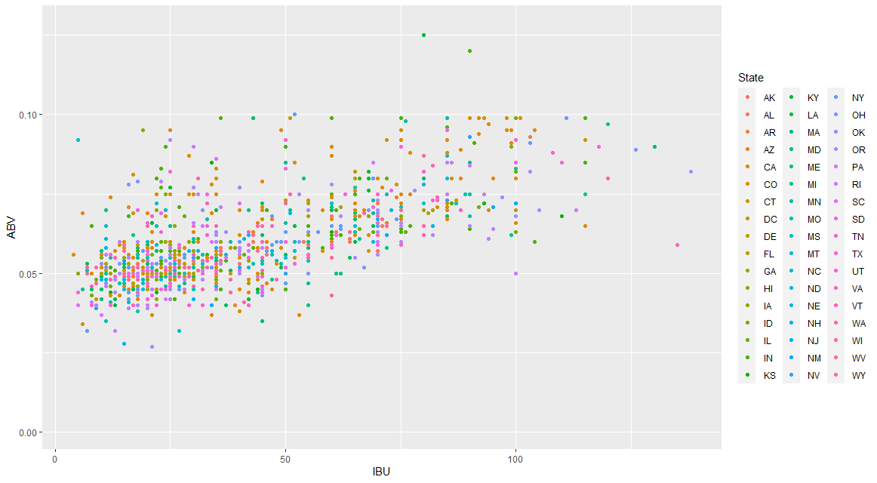
ABV and IBU by State
The plot shows a positive relationship between IBU and ABV
Notes:
Eric-However, the scatterplot shows a positive relationship between IBU and ABV i.e we can say the more the percentage alcohol content, the more the bitterness with r square value of 0.45 showing that increased alcohol content generally resulted in a higher bitterness level.

Slide 11
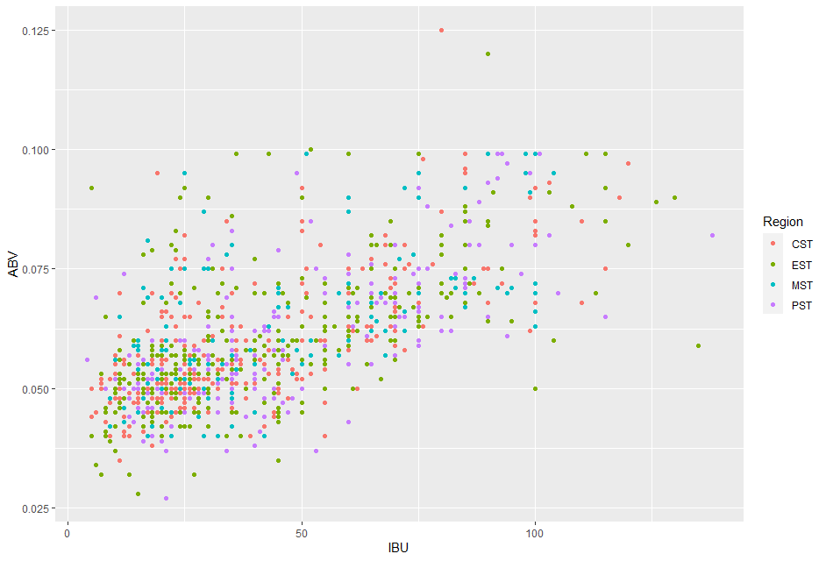
Correlations by Region

Slide 12
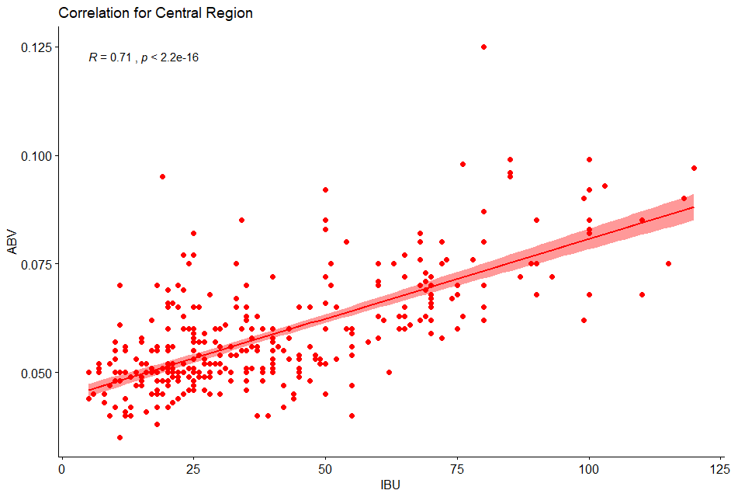
Correlations by Region

Slide 13
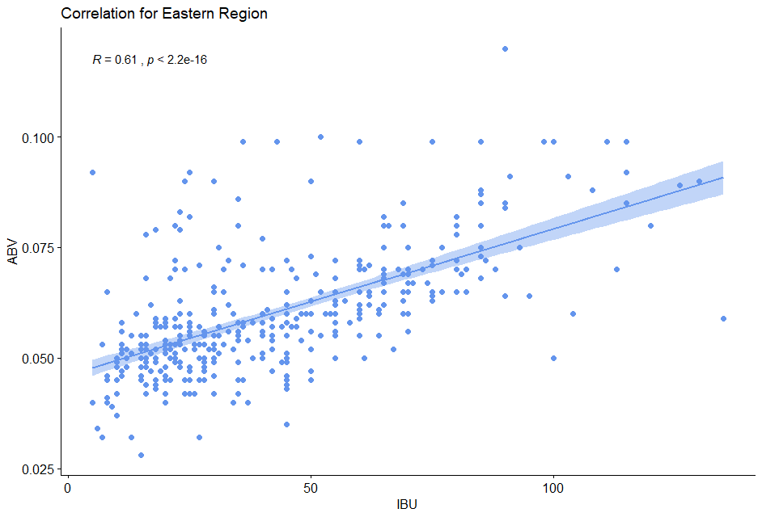
Correlations by Region

Slide 14
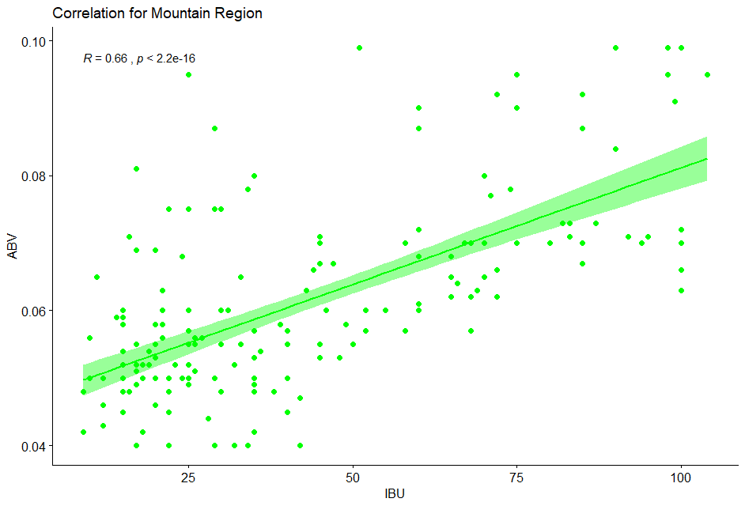
Correlations by Region

Slide 15
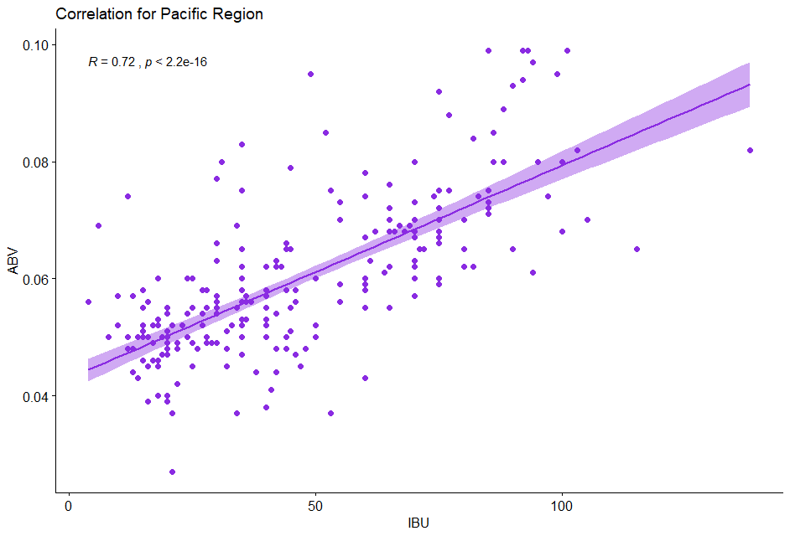
Correlations by Region

Slide 16
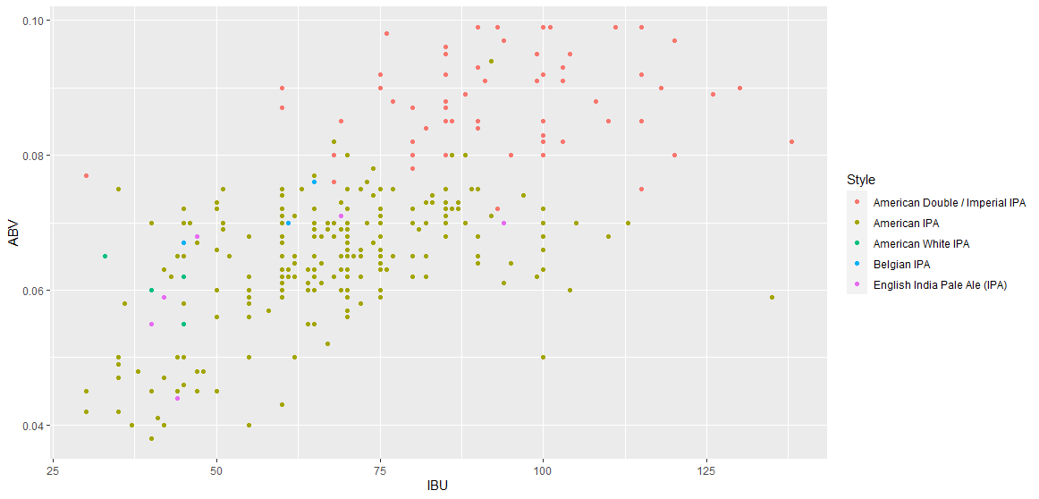
KNN Chart for IPA Styles (ABV and IBU)
Notes:
We used a KNN classifier to look at the differences in IPA style beers which gave greater insight into ABV and IBU analysis. This broke the style down into two main group clusters, American Double/Imperial IPA which had the highest ABV / IBU values and American IPA were the lowest for ABV and IBU.

Slide 17
Overall Statistics K = 31
Accuracy | 0.8189 |  |  | 95% CI: (0.7771, 0.8557)
Class: | American Double/ Imperial IPA | American IPA | American White | Belgian IPA | English IPA
Sensitivity | 0.6533 | 0.9037 | 0 | 0 | 0
Specificity | 0.9085 | 0.5385 | 1 | 1 | 1
Notes:
Eric-This shows the machine learning was 80% accurate at identifying the Imperian and American IPA styles. The other three IPA styles were buried within the large clusters of points for Imperial and American IPA.

Slide 18
Summary
Two data set were provided an we added a third one:
•Beers
•Breweries
•State census data
We started by performing exploratory data analysis on the data sets after they were merged to provide a full overview of the Breweries and beers .
We identify states that appears to be underserved and also the variability of the alcohol contents and bitterness and make recommendations on the improvement that can be make for the growth of the breweries industry.
There is a positive relationship between the ABV and IBU. Our other observation is that ABV is higher on the west coast (PST) and lowest on the east coast (EST).
Notes:
Samuel

Slide 19
Areas of Further Analysis
The data provided only allowed for limited analysis. For more meaningful data, it would be helpful to gather more data and analyze by:
Popularity of each style by state from sales data
Research if state or local laws dictate ABV
Specialized ingredients such as variety of hops or malt used in brewing
Notes:
Amber

Slide 20
Appendix - Data Summary
Variables Characteristics
Name: Name of the beer.
Beer_ID: Unique identifier of the beer.
ABV: Alcohol by volume of the beer.
IBU: International Bitterness Units of the beer.
Brewery_ID: Brewery id associated with the beer.
Style: Style of the beer.
Ounces: Ounces of beer.
Brew_ID: Unique identifier of the brewery.
Name: Name of the brewery.
City: City where the brewery is located.
State: U.S. State where the brewery is located.
Notes:
Samuel

